Slide 1

Basic Details of the Team and Problem Statement
Ministry/Organization Name/Student Innovation: Ministry of Power
PS Code: SIH1300
Problem Statement Title: Automated Public Lighting
Team Name: RoboEmbedders
Team Leader Name: Ankita Gupta
Institute Code (AISHE): C-19344
Institute Name: Symbiosis Institute Of Technology, Pune
Theme Name: Smart Automation

Slide 2
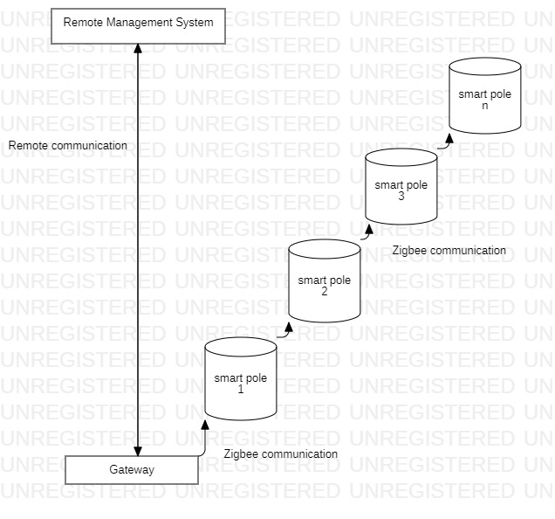
Idea/Approach Details
Describe your idea/Solution/Prototype here:
Automated public lighting systems play an important role in energy consumption reduction. The advancement in wireless networks, control systems, sensors, embedded systems, and IoT made it possible to design automated public lighting systems with smart technologies, where crucial issues like energy savings and cost reduction can be efficiently dealt with. The proposed system is focused on automated public lighting infrastructure. Here, the main idea is to maintain the lamps’ brightness at their minimum allowable level in a certain segment of the street that is compatible with national/regional standards and/or safety limits for both vehicular and pedestrian traffic.
The smart infrastructure highlights the presence of the so-called wireless smart pole. A smart pole is a street light lamp mainly composed by a local control device, a LDR sensors, LiDAR sensors, weather sensors, communication devices and highly efficient LED lamps. The smart poles can exchange data (control commands and information requests) among them and, through a gateway, with a remote management web application. The overall cost of the investment in this type of smart lighting technology is low. The system is also capable of achieving good traffic monitoring performance.
Use Case Diagram - https://github.com/ankita430/Smart-India-Hackathon/blob/main/Automated%20public%20lighting.jpg
System Architecture flow chart - https://github.com/ankita430/Smart-India-Hackathon/blob/main/Automated%20Public%20Lighting%20Architecture.jpg
Simulation code - https://github.com/ankita430/Smart-India-Hackathon/blob/main/code%20repo
Conference Paper - https://github.com/ankita430/Smart-India-Hackathon/blob/main/Automated%20Public%20Lighting.pdf
Describe your Technology stack here:
Wireless smart poles
Local communication devices based on IEEE 802.15.4
Zigbee communication protocol
Remote management station
Remote communication based on 3G/4G/Wi-Fi communication
LDR and LiDAR sensors, Raspberry Pi
Lighting control system

Slide 3
Idea/Approach Details
Smart Lighting Control: LDRs can detect ambient light levels, allowing the smart pole to automatically adjust the intensity of street lighting based on real-time conditions. LiDAR sensors can further refine this by detecting the presence of pedestrians, vehicles, or cyclists, illuminating areas only when needed for added energy efficiency and safety.
Pedestrian Safety: LiDAR sensors can identify pedestrians at crosswalks, and when coupled with LDR data, they can activate warning signals or pedestrian-activated crosswalk lights when ambient light is low, enhancing pedestrian safety.
Security and Surveillance: LDRs can trigger LiDAR-enabled security cameras when lighting conditions change unexpectedly, helping to capture clear images and video footage during low-light situations for improved security.
Navigation Assistance for the Visually Impaired: Smart poles equipped with LiDAR sensors can aid the visually impaired by detecting obstacles in their path and providing audio or tactile feedback for safer navigation.
Describe your Use Cases here
Describe your Dependencies / Show stopper here
https://www.mdpi.com/916592
https://www.researchgate.net/publication/348264646_AUTOMATED_STREET_LIGHTING_SYSTEM_FOR_ENERGY_CONSERVATION
https://www.researchgate.net/publication/225007897_Wireless_Streetlight_Control_System

Slide 4
Team Member Details
Team Leader Name: Ankita Gupta
Branch - M.tech : Stream - EnTc : Year - I
Team Member 1 Name: Sailesh Kumar Pasam
Branch - Mtech : Stream - EnTc : Year - I
Team Member 2 Name: Kshitij Ram Bhosale
Branch - Mtech : Stream - Robotics : Year - I
Team Member 3 Name: Siddhesh Waigankar
Branch – Mtech : Stream- Robotics : Year - I
Team Member 4 Name: Atharva Phand
Branch – Mtech : Stream – Robotics : Year – I
Team Member 5 Name: Aniketh Mehta
Branch – Mtech : Stream - EnTc : Year – I
Team Mentor 1 Name: Dr. Paresh Nasikkar
Category - Academic : Expertise - Solar : Domain Experience 10+ years:
Team Mentor 2 Name: Type Your Name Here
Category (Academic/Industry): Expertise (AI/ML/Blockchain etc): Domain Experience (in years):

Slide 5
Important Pointers
Please ensure below pointers are met while
Kindly keep the maximum slides limit to 4 pages
All the topics should be utilized for description of your idea
Try to avoid paragraphs and post your idea in points
Keep your explanation precisely and easy to understand
Idea should be unique and novel. If it has a business potential more weightage will be given.
Apart from this PPT abstract of your idea will be asked separately while submitting
You need to save the file in PDF and upload the same on portal. No PPT, Word Doc or any other format will be supported
You can delete this slide (Important Pointers) when you upload the details of your idea on SIH portal.

